Slide 1

AIET Project
Team Number: 20
Team Name: Andrew NG
CLASSIFICATION OF REAL WORLD IMBALANCED DATASETS

Slide 2
Agenda
A brief About Project Group Name
Team members
Problem statement
Related work
Datasets
Methods and model
Experiments and results
Future work
Conclusion
Q & A

Slide 3
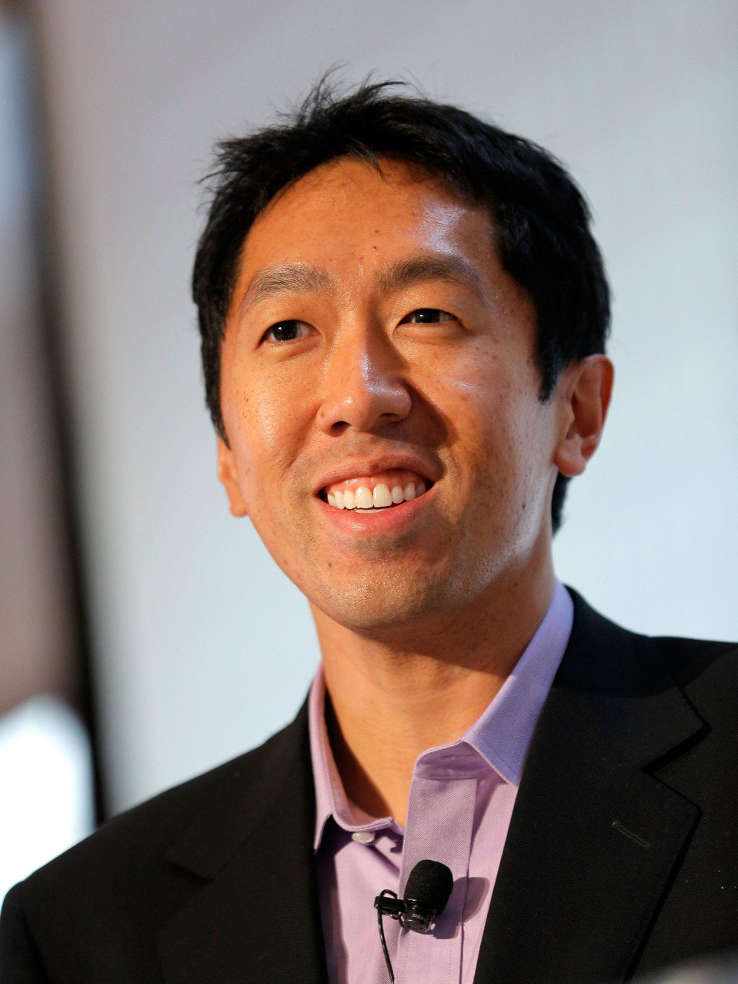
Brief about the Project Group Name- Andrew NG
Completed his undergrad from Carnegie Mellon University, Graduation and Triple masters from MIT and PhD from University of California, Berkeley.
Ng researches primarily in machine learning, deep learning, machine perception, computer vision, and natural language processing.
Few of the most talked about projects till date: Stanford Autonomous Helicopter project, AI Robot Project, Google Brain Project at Google and Stanford WordNet projects
His paper along with Michael and David on Latent Dirichlet allocation influenced millions.
And finally his online course on Coursera is something no one not knows about it.

Slide 4
Team Members
Mentor : Nandan Kumar Jha
Annie Chandolu
Anusree Kanadath
Meenakshi Somisetty
Ravalika Reddy Aduri
Sushmitha Vulapalli

Slide 5
Problem Statement
Classifying imbalanced Education Loan Dataset in order to give better prediction probability of sanctioning the loan.
‘Accuracy' is not a good measure for evaluating the performance of the classifiers (Accuracy Paradox); and generalisation being a big challenge for such a dataset other parameters have been considered to classify the data in a much better format.
Better Accuracy
Better Generalization

Slide 6
Related work
Initially Naïve Bayes Classifier, was used but accuracy was not a good metric for the data set we took into consideration.
To overcome the problem faced, K-fold cross validation was implemented which did not fetch good result.
Hence, XGB algorithm which gave us a better output in terms of AUC. The probabilities are used to identify which class a particular input belonged to.
H1-B visa for the year 2018 was another dataset which dealt with four classes, which was partially implemented and the preprocessing of that dataset was challenging.

Slide 7
Datasets
Loan application imbalanced dataset is a binary class dataset. The input belongs to either class 1 or class 0 based on several attributes.
In order to try other models we took another data set which had around 10,000 test data and 32,000 training data entries for applying H1-B1 visa and the output was in four classes.
In the Pre-processing of the dataset we have converted the categorical values to numerical values, and replaced missing values with averages.
Following links will guide you to the datasets we have considered
trainData.csv
testData.csv
h1trainData.csv
h1testData.csv

Slide 8
Methods and model
We are using XGBoost classification algorithm for classifying Educational Loan dataset
XGBoost stands for eXtreme Gradient Boosting.
XGBoost is an implementation of gradient boosted decision trees designed for speed and performance.
XGBoost is a software library that you can download and install on your machine, then access from a variety of interfaces.
Three main forms of gradient boosting are supported:
Gradient Boosting algorithm also called gradient boosting machine including the learning rate.
Stochastic Gradient Boosting with sub-sampling at the row, column and column per split levels.
Regularized Gradient Boosting with both L1 and L2 regularization.
The main parameters in XGBoost are max_depth, scale_pos_weight, gamma, nthread, max_delta_step, etc.,

Slide 9
EXPERIMENT AND RESULTS

Slide 10
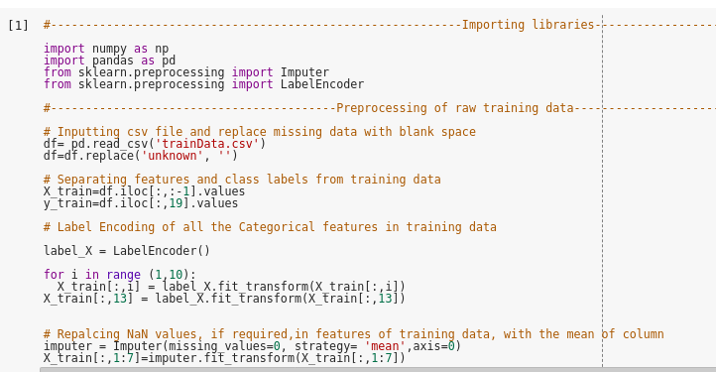
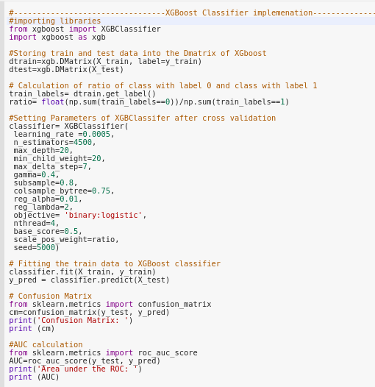
Fig 2: XGBoost Classifier is the model used to train and fit data
Fig 1: The code snippet shown above data preprocessing
of the Educational Loan dataset

Slide 11
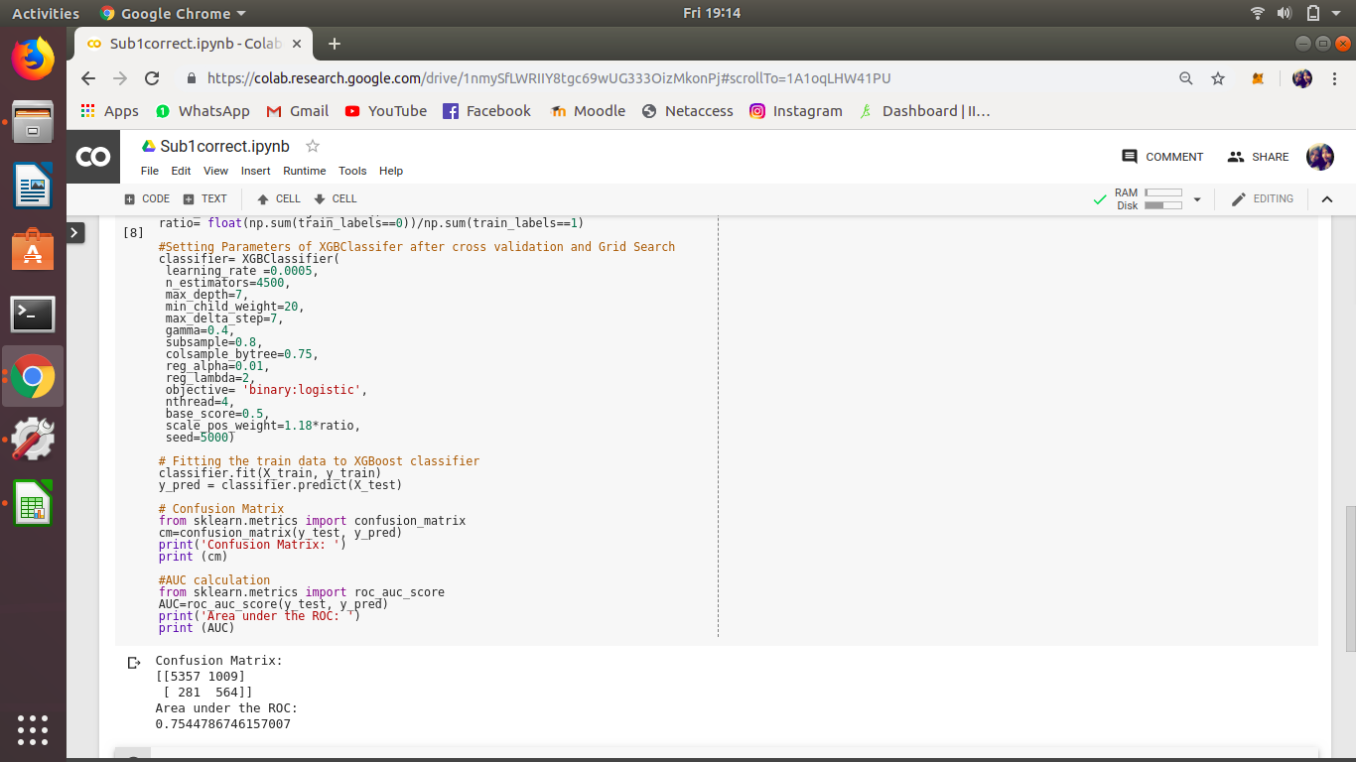
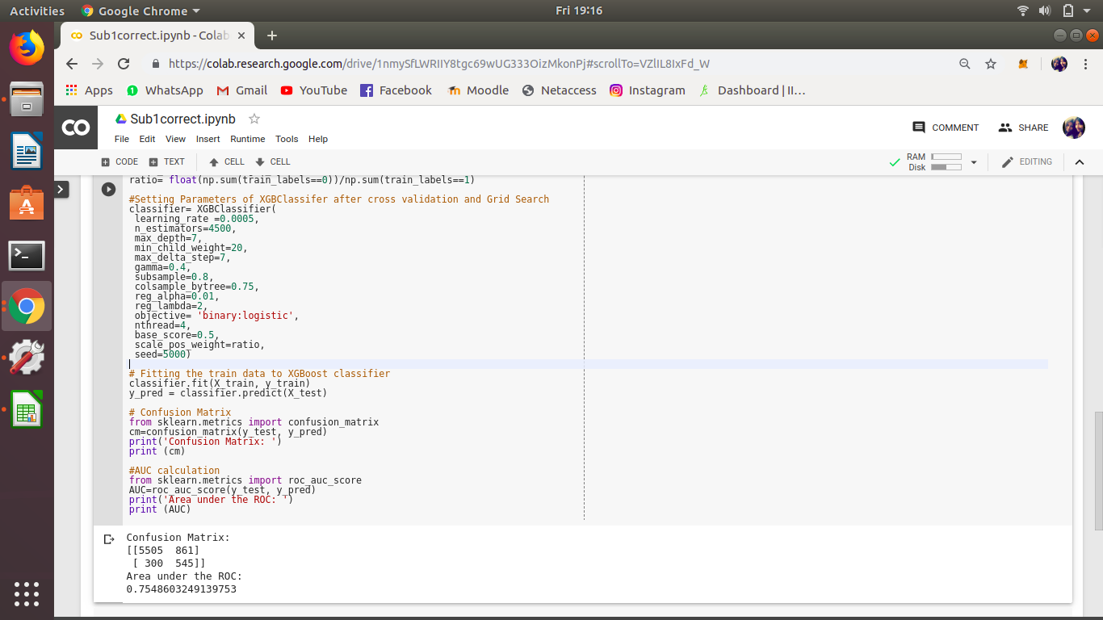
The AUC under the ROC when the max_depth is 7 and scale_pos_weight is 1.18*ratio
The AUC under the ROC when the max_depth is 7 and changing scale_pos_weight to ratio

Slide 12
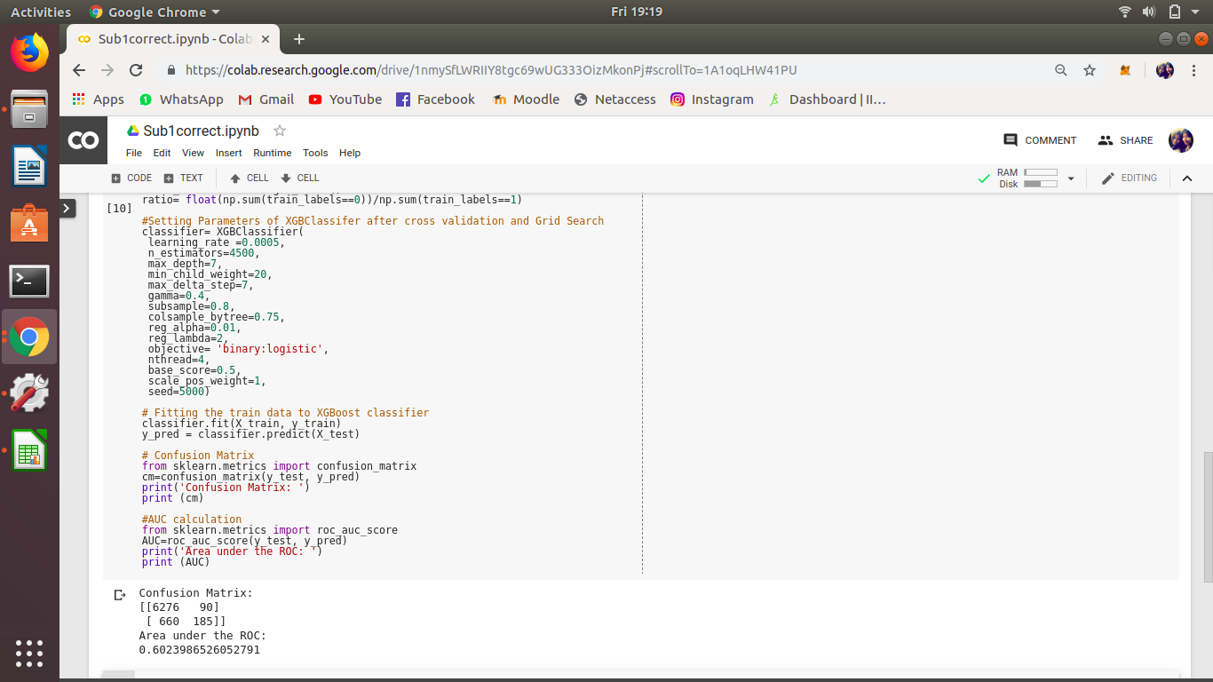
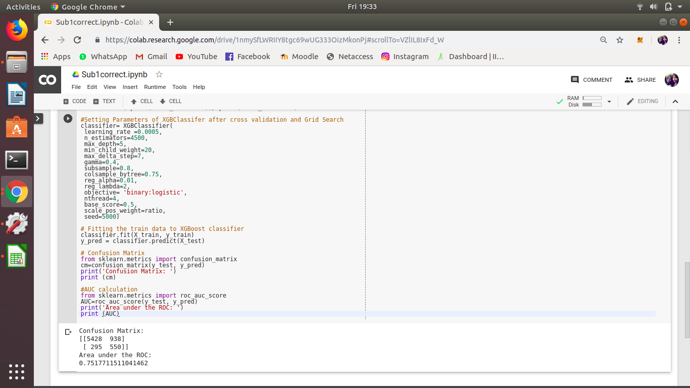
The AUC under the ROC when keeping the max_depth to 7 and changing the scale_pos_weight to 1
The AUC under the ROC by changing the max_depth to 5 and keeping the scale_pos_weight to ratio

Slide 13
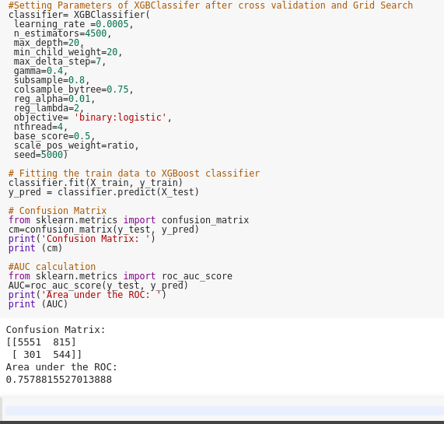
S.No | scale_pos_weight | max_depth | AUC
1. | 1 | 7 | 0.602
2. | 1.18*ratio | 7 | 0.754
3. | ratio | 7 | 0.754
4. | ratio | 5 | 0.752
5. | ratio | 20 | 0.758
ratio = (no. of inputs in class 0) / (no. of inputs in class 1)
The AUC under the ROC when changing the max_depth to 20 and maintaining the scale_pos_weight to ratio
The table shown above is a comparison table of all the AUCs calculated by changing the max_depth or the scale_pos_weight.

Slide 14
Future work
As of now, the algorithm works on binary classification. It can be extended to multi-class classification problem as in the case of H1visa dataset were the classes were “Certified”, “denied”, “Certified-Withdrawn”, “Withdrawn”.
One of the main ways to approach this method is to use the one versus all method and then find the average of it.
Ensemble methods of same classifiers by varying parameters and different classifiers on varying parameters is another approach that can be worked on.
Other common areas where the data set is imbalanced are: Health sector and Fraud detection.

Slide 15
Conclusion
At the end, fine tuning of specific parameters on the model was achieved. And for imbalanced datasets Metrics like AUC and Confusion matrix delivered good results in comparison to Accuracy. And finally data preprocessing has to be done with utmost precision even though it does take a lot of time as only if that step is done well, will the outcome be proper and the desired one.

Slide 16


Slide 17


